Slide 1

BIG MART SALES FORECASTING FORCASTING SALES FOR STRATEGIC INVENTORY MANAGEMENT
Subject: BSAN775 - Introduction to Business Analytics
Professor: Dr.Murtaza Nasir
Team: Group 10
(INDRA PRASAD CHEVVA – V348X788)
(ALLA MITHILESH REDDY– X745C355)

Slide 2


Introduction
Nowadays, shopping malls and Big Marts keep track of individual item sales data to forecast future client/customers demand and adjust inventory management.
In a data warehouse, these data stores hold a significant amount of consumer information and particular item details. By mining the data store from the data warehouse, more anomalies and common patterns can be discovered.

Slide 3
Business problem objective & significance
Big mart needs to leverage its sales data to forecast future demand accurately, ensuring efficient inventory management.
To develop a predictive model using ai algorithms that can predict sales for each product at specific outlets.
Understanding the influence of product and outlet characteristics on sales to optimize inventory and increase profitability.

Slide 4
LITERATURE REVIEW
Sales forecasting is crucial for businesses to anticipate market demands and manage resources effectively. Various machine learning methods, such as linear regression, decision trees, and advanced techniques like random forests and XGBoost, are extensively used to enhance predictive accuracy by analyzing historical sales data. Data preprocessing, including the treatment of outliers and missing data, plays a vital role in the reliability of these forecasts. Recent advancements in artificial neural networks, particularly deep learning models like ANNs and MLPs, have shown potential in capturing complex non-linear relationships, significantly improving forecast precision. This comprehensive analysis indicates that integrating diverse machine learning techniques can yield superior forecasting results, essential for strategic business planning and inventory management (Thivakaran & Ramesh, 2022).
Reference:
Thivakaran, T. K., & Ramesh, M. (2022). Exploratory Data analysis and sales forecasting of bigmart dataset using supervised and ANN algorithms. Measurement: Sensors, 23(100388). https://doi.org/10.1016/j.measen.2022.100388

Slide 5
Project Methodology
Data acquisition.
Data cleaning & Preprocessing steps
Exploratory data analysis.
Feature engineering
applying ai algorithms
Evaluation.

Slide 6
Data Acquisition
The project data has been downloaded from Kaggle.
The data set chosen has different variables like item identifier, item mrp, outlet type, outlet location etc. These factors would impact on the price of the product at each outlet.
Notes:
Source of data: https://www.kaggle.com/datasets/quantbruce/real-estate-price-prediction

Slide 7
Data Description
Variable Description
• Item identifier : unique product ID
• Weight : weight of products
• Fat Content : specifies whether the product is low on fat or not
• Visibility : percentage of total display area of all products in a store allocated to the particular product
• Product Type : the category to which the product belongs
• MRP : Maximum Retail Price (listed price) of the products
• Outlet ID : unique store ID
• Establishment Year : year of establishment of the outlets
• Outlet Size : the size of the store in terms of ground area covered
• Location Type : the type of city in which the store is located
• Outlet Type : specifies whether the outlet is just a grocery store or some sort of supermarket
Target variable: Outlet Sales : sales of the product in the particular store

Slide 8
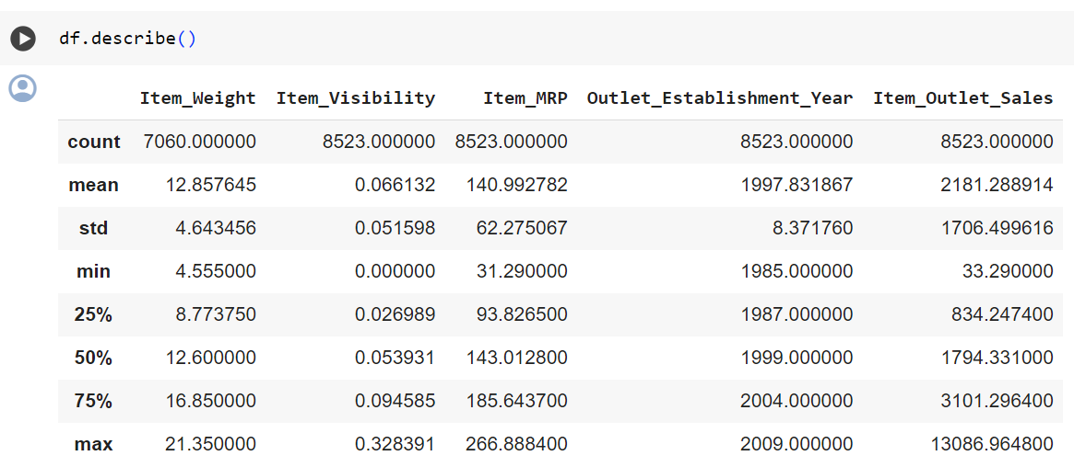
Data preprocessing steps
DESCRIPTIVE STATISTICS:

Slide 9
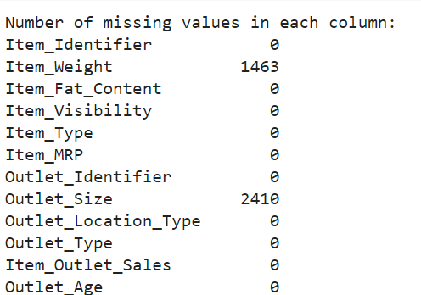
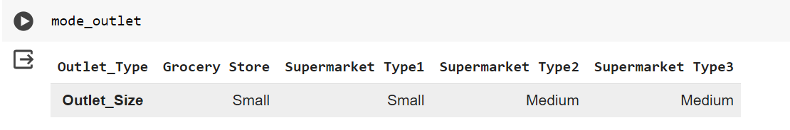
Data Cleaning
There are missing values in data set.
Imputed missing values of Item weight by checking Item identifier column and replacing value with respective item identity number
Group the data by ‘outlet type' and calculate the mode of ‘outlet type' for each group. Fillled the missing values in 'Item_Weight' with the corresponding mode value

Slide 10
Data Cleaning & Feature engineering
Combining same categories into one category
Unique values in column 'Item_Fat_Content':
['Low Fat' 'Regular' 'low fat' 'LF' 'reg’]
But actually 'Low Fat’, ‘LF’, 'low fat’ are same category so we are combing them into one single category named as 'Low Fat’.
But actually 'reg’, 'Regular’ are same category so we are combing them into one single category named as ''Regular’.
Creating new variable Outlet age
We have Unique values in column 'Outlet_Establishment_Year':
[1999 2009 1998 1987 1985 2002 2007 1997 2004]
# Create a new column - outlet age
Outlet_Age = current_year - Outlet_Establishment_Year

Slide 11
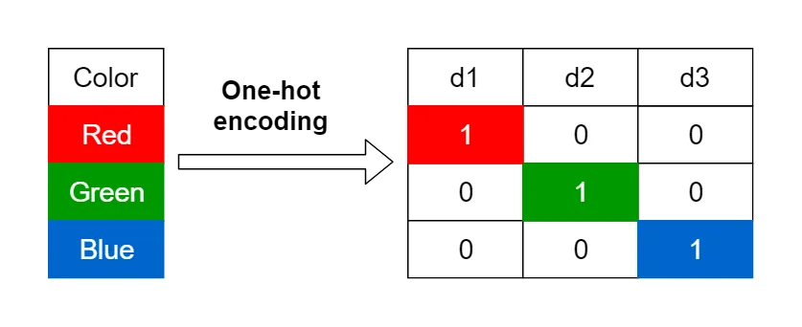
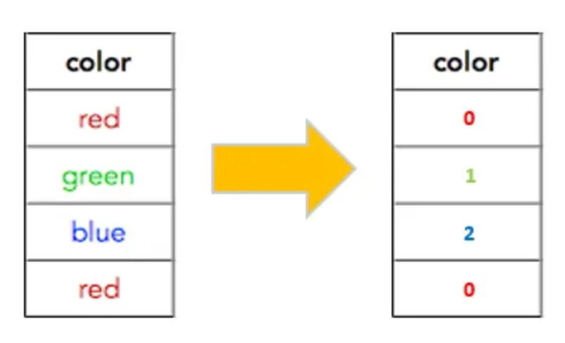
Handling Categorical variables
Label Encoding
Columns -
Outlet_Size, Outlet_Age, Item_Identifier
One hot Encoding
columns - Item_Fat_Content, Item_Type, Outlet_Identifier, Outlet_Location_Type, Outlet_Type

Slide 12
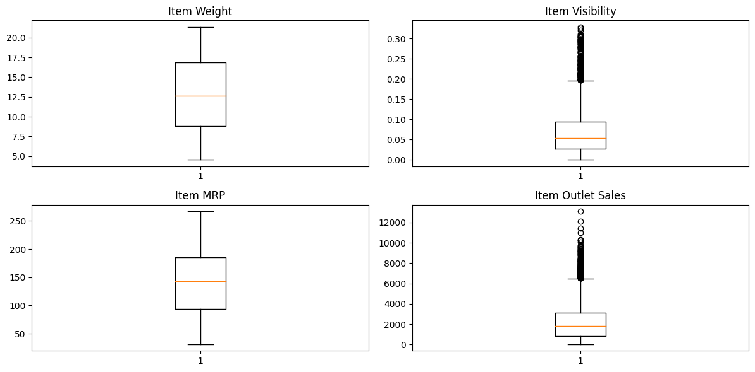
DETECT AND REMOVE OUTLIERS USING BOXPLOT
removed the top and bottom 5% of values in columns where outliers were detected. (using percentiles)

Slide 13
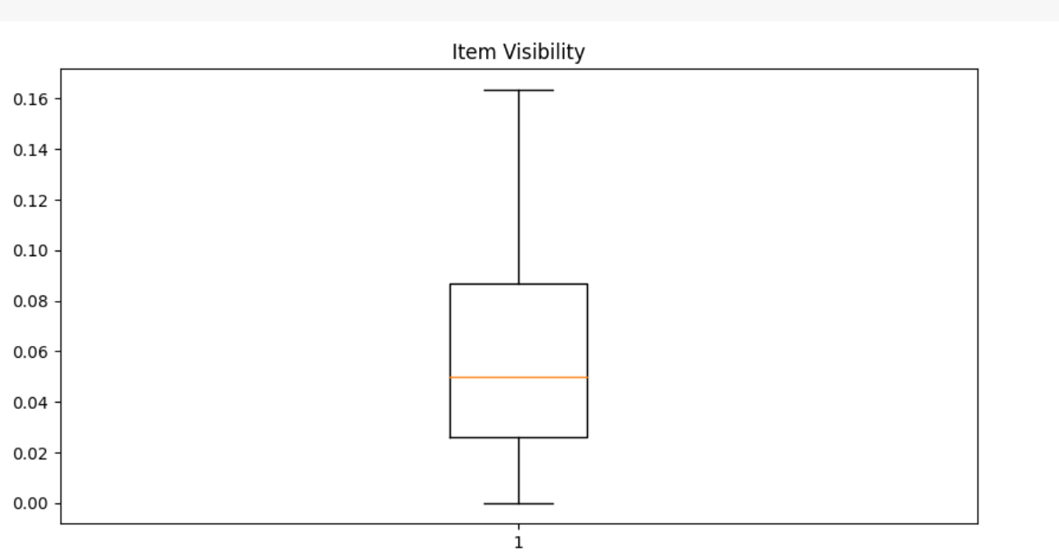
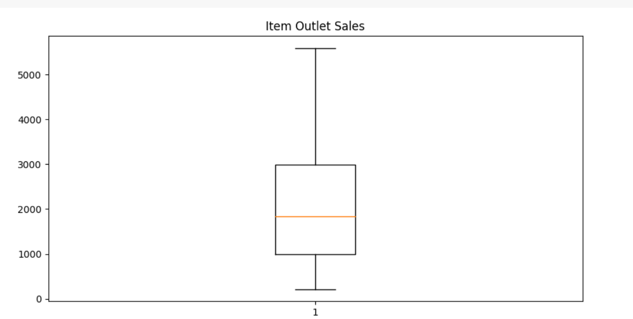
Cross checking whether outliers are removed or not

Slide 14
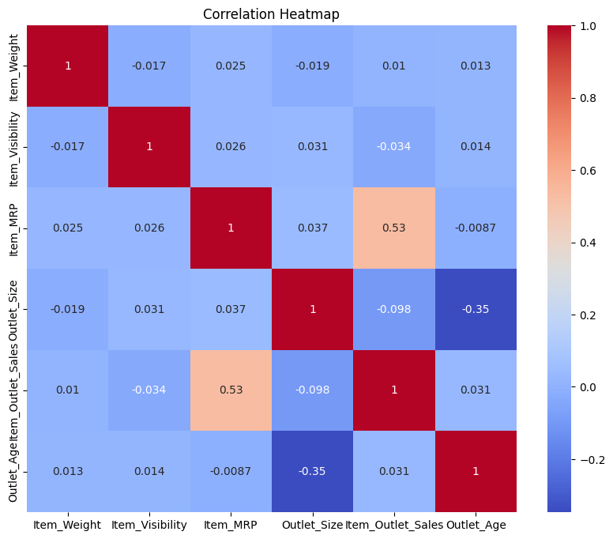
Correlation
There is no multi collinearity problem between independent variables

Slide 15
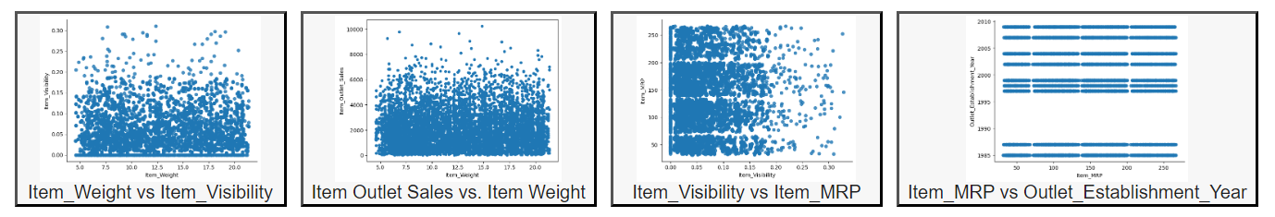
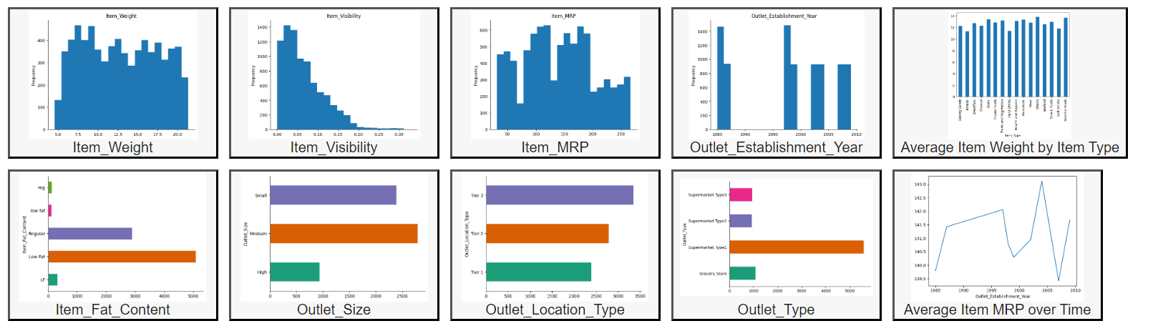
Data Visualization & eda analysis

Slide 16
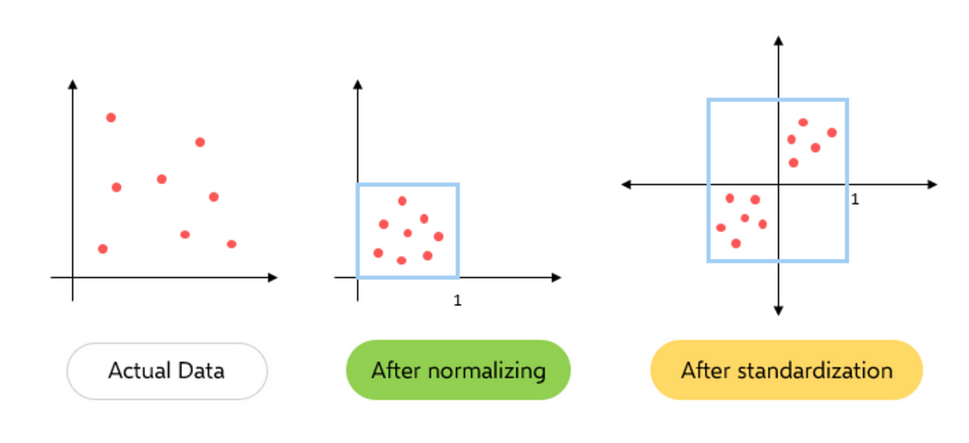
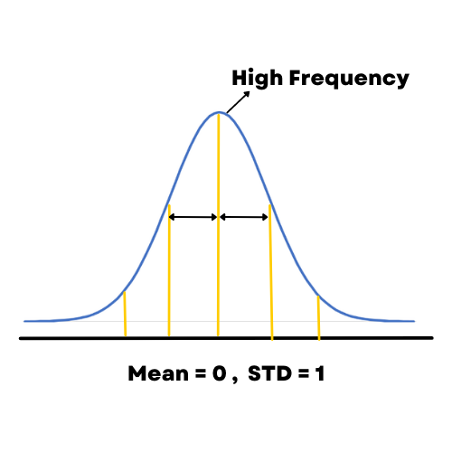
Data standardization
Standardization transforms feature values to a distribution with a mean of zero and a standard deviation of one.

Slide 17

Data Splitting
Original Data frame has - Number of rows: 8523 & Number of columns: 12
Divided data set into training set and test set with 30% for testing, 70% for training
Training DataFrame:
(5098, 42)
Test DataFrame:
(2185, 42)

Slide 18
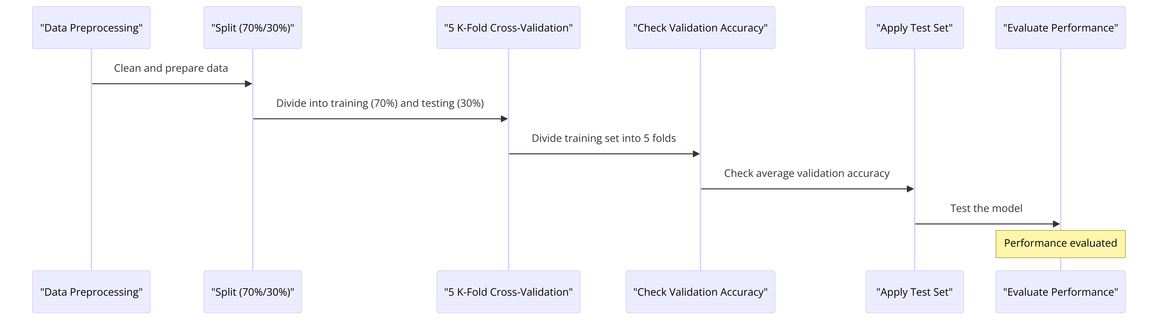
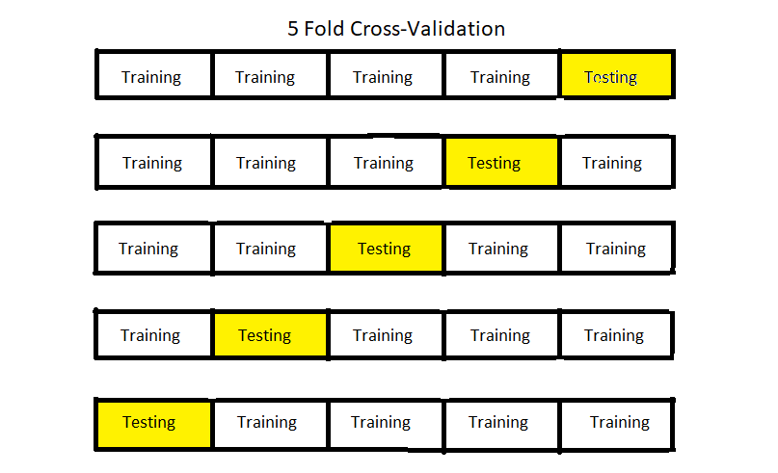
Models specifications & design

Slide 19

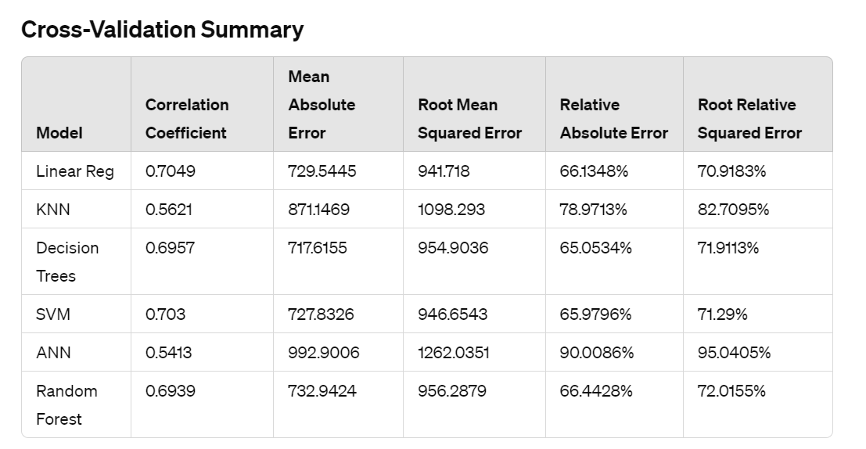
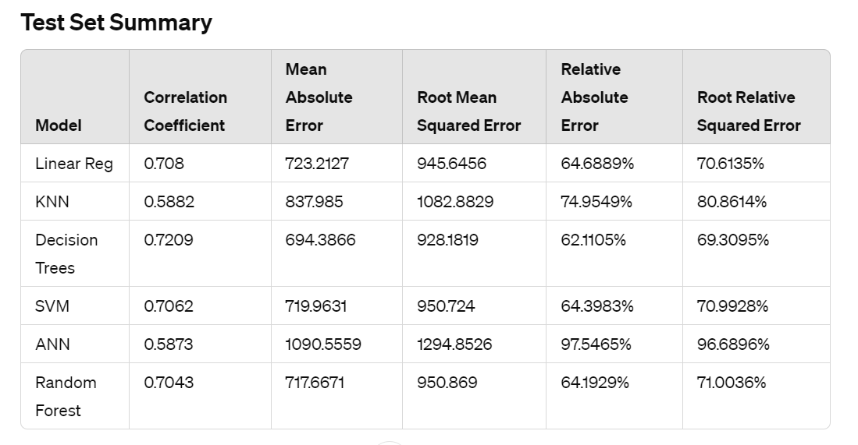
Model Results

Slide 20
Final result & Conclusion
Best Model Evaluation:-
Correlation Coefficient: Higher values are better. Decision Trees perform the best in the test set. Validation set : 0.6957 & Test set : 0.7209.
Mean Absolute Error (MAE) and Root Mean Squared Error (RMSE): Lower values are better. Decision Trees have the lowest MAE and RMSE in the test set. MAE for Validation set : 717.6155, Test set : 694.3866 & RMSE for Validation set : 954.9036, Test set : 928.1819.
Relative Absolute Error (RAE) and Root Relative Squared Error (RRSE): Lower values are better. Decision Trees again show the best performance in terms of RAE and RRSE in the test set. RAE for Validation set : 65.0534%, Test set : 62.1105% & RRSE for Validation set : 71.9113%, Test set: 69.3095%.
Based on these metrics, the Decision Trees model appears to perform the best on the test set, showing strong correlation and lower error rates compared to other models. This analysis helps in making an informed decision on which model to use for deployment or further tuning.

Slide 21
Further Model Tuning and ValidatioN
Choose meta cv parameters wrapper filter to select best parameters for each model
Choose meta attribute selection wrapper filter to select best variables for model
Try with different cross validation K folds
Try with different percentage of split for training set & testing set
Try Ensemble models with similar number of models
Try Ensemble models with different number of models
Auto Weka Classifier – gives best model with best parameters

Slide 22

Any discussions or questions?

Slide 23
THANK YOU.

